Slide 1
Artificial Neural Networks in Keras

Slide 2
Outline
Biological Inspiration
Installing Keras
Keras Basics
Building and compiling models
Training and Evaluation
Convolutional Neural Networks
Keras Demo
AutoEncoders
Recurrent Neural Networks
Advanced Keras Features

Slide 3
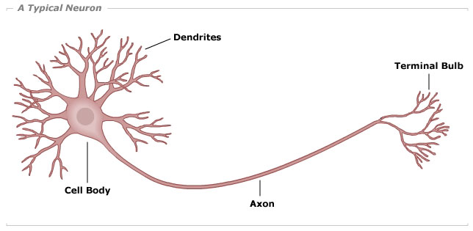
Biological Neuron

Slide 4
Biological Neuron
Dendrites – receive signals from large numbers of cells (can be >1000). Can adjust strength of signals by varying ratio of synaptic neurotransmitters to signal chemicals. Decreasing ratio increases signal strength. Signal inhibitors can decrease signal.
Soma – positive and negative signals from dendrites produce positive and negative charged ions in the soma.
Axon – sends an output signal when a sufficiently large charge is reached in the soma.

Slide 5
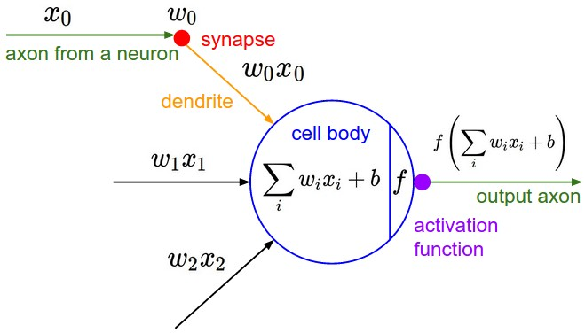
The Artificial Neuron

Slide 6
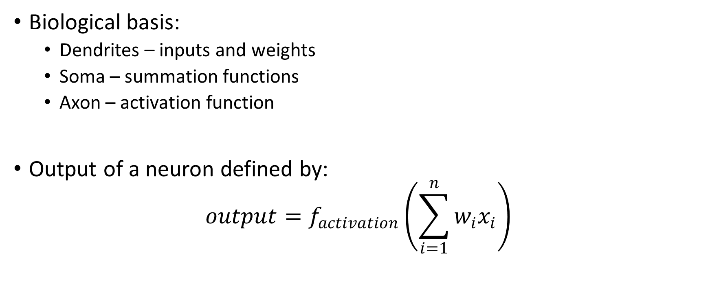
Artificial Neuron
Biological basis:
Dendrites – inputs and weights
Soma – summation functions
Axon – activation function
Output of a neuron defined by:
$$output=f_{activation}\left(\sum_{i=1}^{n}{w_{i}x_{i}}\right)$$

Slide 7
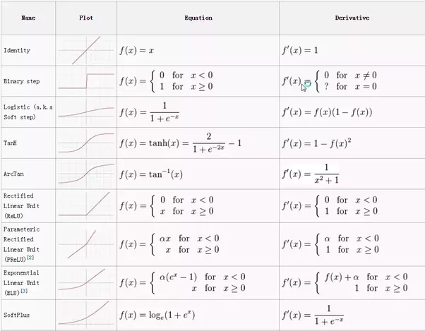
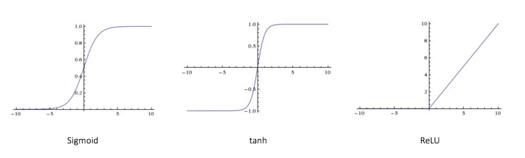
Activation Functions

Slide 8
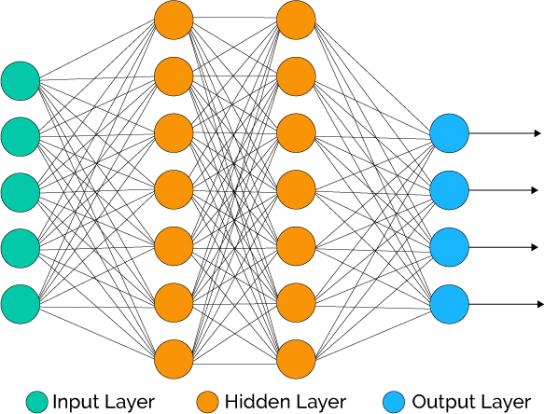
Artificial Neural Network

Slide 9
Artificial Neural Networks
Many types of networks for many different applications
Fully connected networks
Convolutional networks
Recurrent Neural Networks
Auto Encoders
Classification
Feature Extraction
Generative Networks
Reinforcement Learning

Slide 10
Installing Keras

Slide 11
Keras
The first few assignments in keras will require the following:
Load data with correct format
Build and compile model
Train and evaluate model
Comprehensive documentation for keras can be found at: https://keras.io/

Slide 12
Keras Data format
Keras expects data to be stored in numpy arrays, an N dimensional array like data structure provided by the NumPy package, a fundamental component for most scientific computing in Python.
NumPy provides functions to load CSVs and other file types into numpy arrays.
Datasets included with keras are loaded as numpy arrays, functions for datasets used in this class not included in keras will be provided to correctly load the data.
Keras expects data to be split into X and Y components (features and class attribute).
Features must be numeric and should be normalized to be between 0 and 1
Class should be categorical and can be a Nx1 array of labels for data with two classes, or an NxM array for data with M classes

Slide 13
Common Layer Types
Activation
Convolutonal
Dense
Dropout
Flatten
Pooling
Recurrent

Slide 14
Building a Model
Keras provides two APIs for creating models.
Sequential API
Create a model and add layers sequentially.
Easy to use/understand
Functional/model API
Define layers with specific names and inputs
Allows more complicated networks to be created with multiple paths for signals to travel, multiple outputs or shared layers

Slide 15
Sequential API: MLP
model = Sequential()
model.add(Dense(128, input_dim=input_dim))
model.add(Activation('relu'))
model.add(Dense(nb_classes))
model.add(Activation('softmax'))

Slide 16
Functional API: MLP
inputs = Input(shape=(input_dim,))
hidden1 = Dense(128, activation = 'relu')(inputs)
predictions = Dense(nb_classes, activation = ‘softmax')(hidden1)
model = Model(inputs = inputs, outputs = predictions)

Slide 17
Compiling A model
Requires a loss function, optimizer and performance metric
model.compile(loss='categorical_crossentropy',
optimizer= 'adam',
metrics=['accuracy'])

Slide 18
Visualizing Optimizers

Slide 19
Visualizing Optimizers

Slide 20
Training a Model
Use model.fit(), specify training and validation data (or a validation split), batch size and number of training epochs.
model.fit(x_train, y_train, batch_size=batch_size, epochs=nb_epoch,
verbose=1, validation_split=0.1)

Slide 21
Evaluating a Model
Use model.evaluate() with test data. Outputs array containing performance metrics.
score = model.evaluate(x_test, y_test)

Slide 22
Convolutional Neural Networks
Inspired by the cat and monkey visual cortex
Receptive field – region of visual space within which visual stimuli affect the firing of a single neuron.
Neighboring cells have similar and overlapping receptive fields
Receptive field size varies systematically, forms complete map of visual space
Convolutional layers define 1 or more receptor fields which are then convolved across the input to produce feature maps.
ConvNets are generally constructed from a mix of convolutional layers, Max Pooling layers and fully connected layers

Slide 23
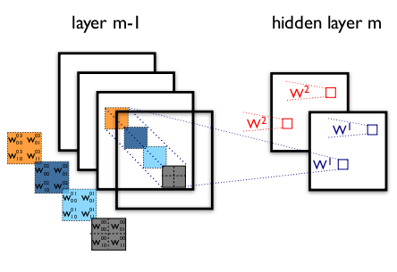

Receptor Field and Feature Mapping
Kth feature map is defined as: $h_{ij}^{k}=f_{activation}\left({\left(W^{k}∗x\right)}_{ij}+b_{k}\right)$

Slide 24
Receptor Field and Feature Mapping

Slide 25
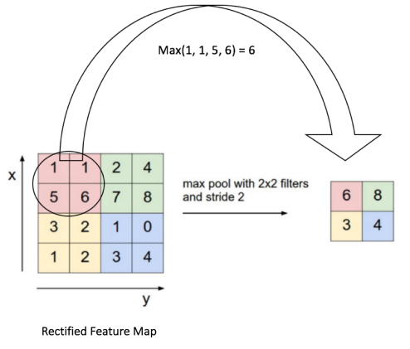
Max Pooling

Slide 26
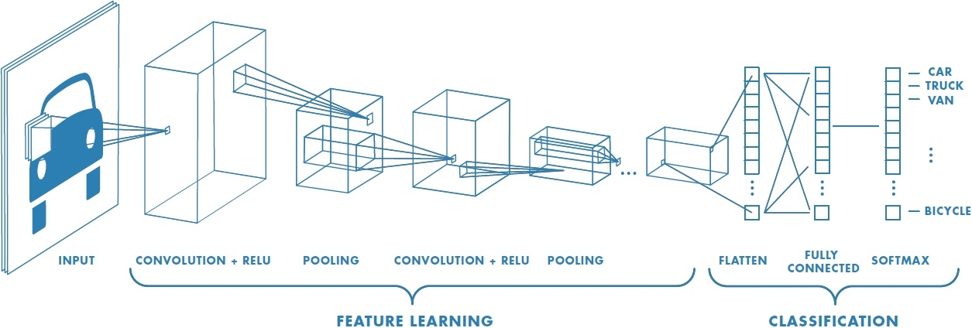
Putting it Together

Slide 27
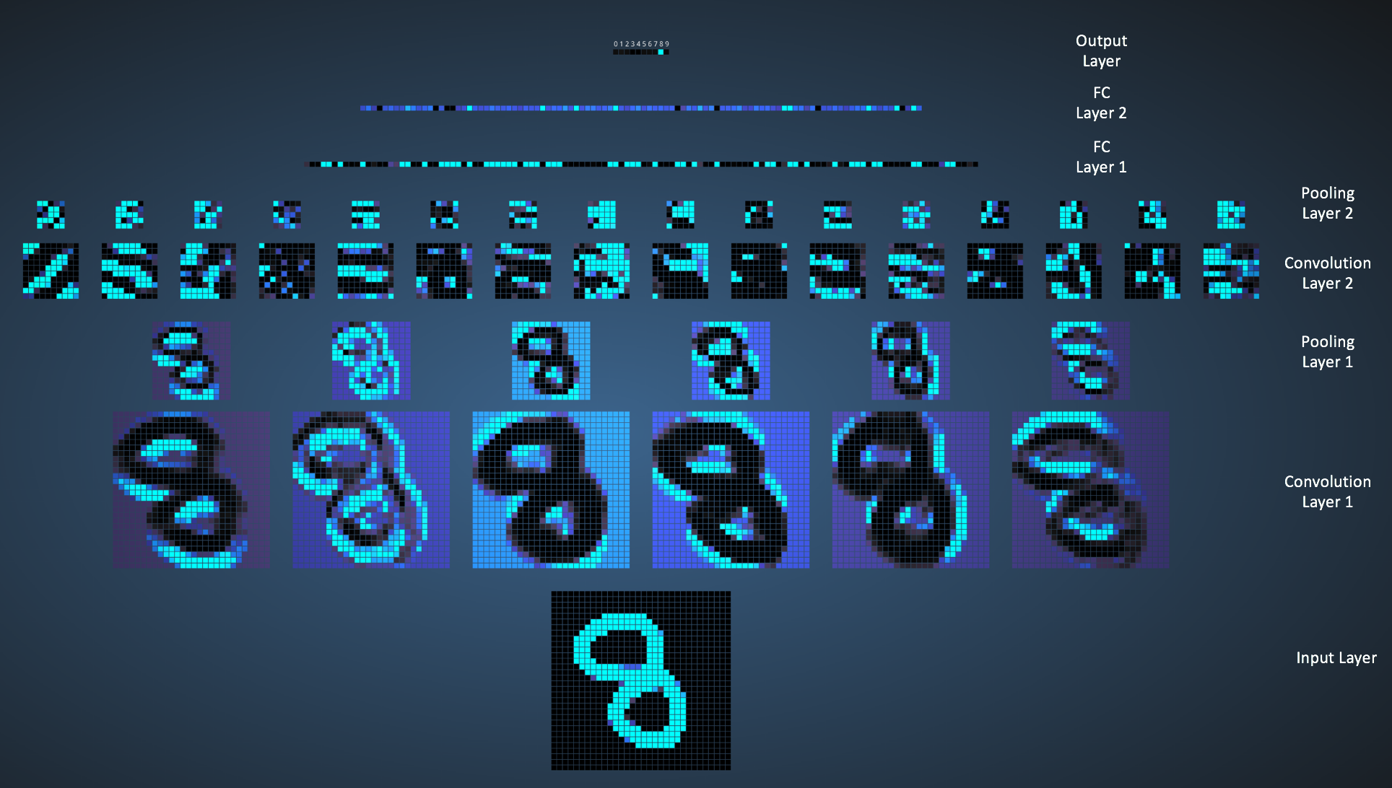

Slide 28
Conv Network example
model = Sequential()
model.add(convolutional.Conv2D(32, (3, 3),
input_shape=(img_channels, img_rows, img_cols)))
model.add(Activation('relu'))
model.add(MaxPooling2D())
model.add(Flatten())
model.add(Dense(128))
model.add(Activation('relu'))
model.add(Dropout(0.5))
model.add(Dense(10))
model.add(Activation('softmax'))

Slide 29
Demo
Data: mnist (hand written digits)
Task: correctly identify instances as 0 through 9
Loading mnist data
MLP
CNN

Slide 30
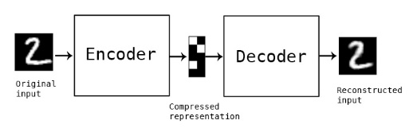
AutoEncoder

Slide 31
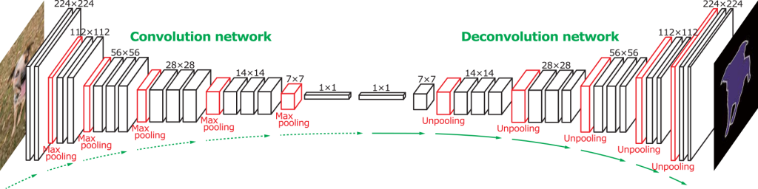
Conv AutoEncoder

Slide 32
Conv AutoEncoder example
model = Sequential()
model.add(Conv2D(32, (3, 3), input_shape=(img_channels, img_rows, img_cols)))
model.add(Activation('relu'))
model.add(MaxPooling2D((2, 2))
model.add(Conv2D(32, (3, 3)))
model.add(Activation('relu'))
model.add(UpSampling2D((2, 2)))
model.add(Conv2D(1, (3, 3))
model.add(Activation('sigmoid'))

Slide 33
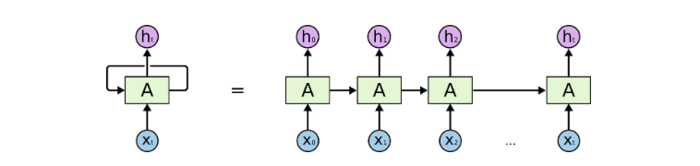
Recurrent Neural Networks
Use past and present information
Good for sequential data (text, speech, time series etc.)

Slide 34
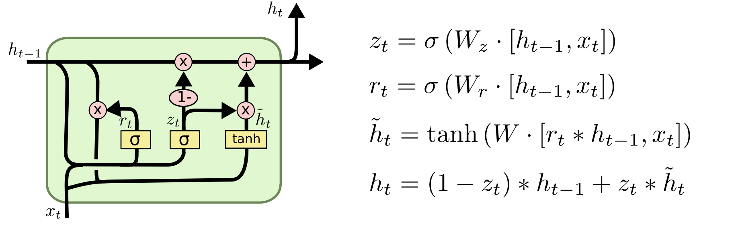
Long Short Term Memory Network

Slide 35
LSTM example
model = Sequential()
model.add(LSTM(100, input_shape=(10,140))
model.add(Dense(2))
Model.add(Activation('sigmoid'))

Slide 36
Advanced Keras Features
Callbacks
Model/Function API
Preprocessing
Backend
User defined

